Slide 1
Lambda Architecture for Cost-effective Batch and Speed Big Data processing
By: Jordan Donovan

Slide 2
Motivation
High volumes of data
Analysis of data is beneficial
Cost-effectiveness is important
Notes:
High Volumes of Data:
Constant growth in devices (smart phones, sensors, household appliances, etc.)
Several varieties of datatypes
Present various challenges for data-as-a-service applications
Analysis of Data is Beneficial:
On-the-fly, real-time analysis
Capability to discover previously unknown behaviors
Cost-effictiveness is important:
Public clouds will minimize costs and network resources and provide on-demand availability
Multiple vendors deliver these services on a pay-as-you-go model
Is there a better method

Slide 3
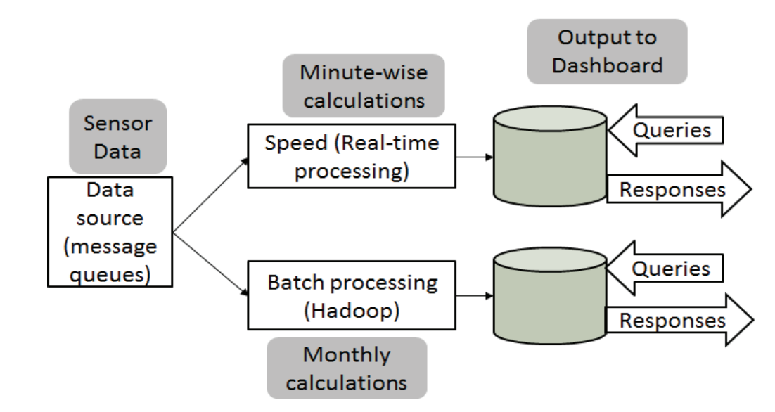
Contribution
Lambda architecture for cost savings
Notes:
Lambda Architecture
Batch processing
Speed / real-time processing
A layer to respond to queries
Allows user to optimize costs by understanding data and partitioning it. Calculations can be done to these partitions.
Verify data as it comes in with real-time processing
Store this data
Run batch scripts on this data at time intervals

Slide 4
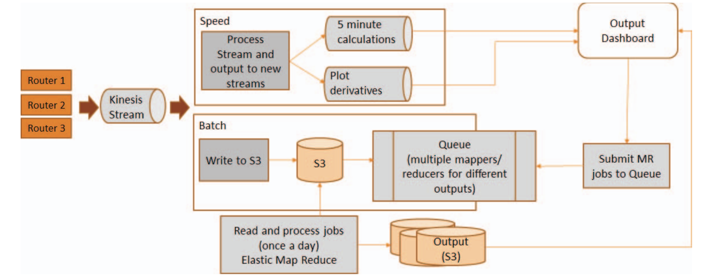
Proposal
Lambda Architecture built on Amazon Web Services (AWS)
Notes:
Real-time / speed processing:
30 second intervals (omitted event processing)
Read, processed, and used to calculate averages every 5 minutes
The averages were then output for visualization
Batch Processing
Using Hadoop instead of Spark Sql
Consolidated data on 1 day, 7 day, 90 day, and 1 year intervals
Outputs stored in S3 buckets and also visualized in output
EMR scripts used c1.medium machines
This architecture presents a cost-effective solution to big data processing

Slide 5
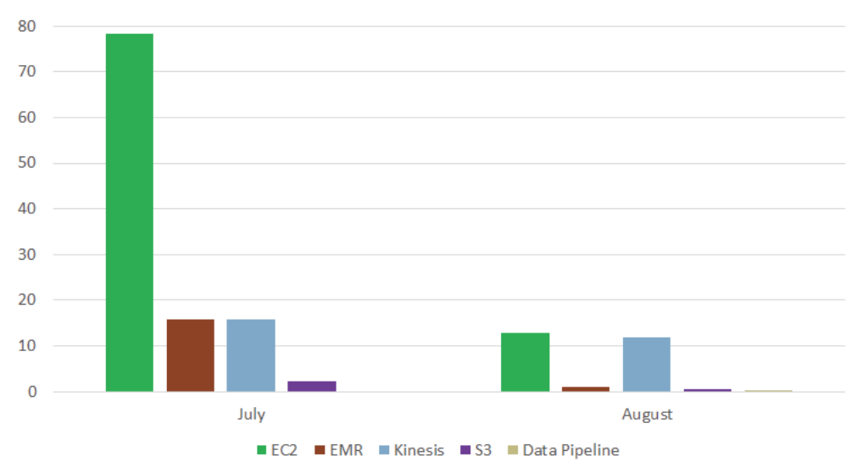
Result
Cost per service for two months of experiment
Notes:
Proof of concept of cost-effective manner of big data processing.
Month 3 brings this cost down even further making it even more affordable.
Micro-machines were much cheaper than larger machines. Thus using smaller machines like the c1.medium or smaller and having more nodes will lead to further cost savings.
Most of the kinesis cost was stream hosting the data. This can be optimized in the future by controlling that time.
There were several lessons learned from this experiment as well.

